Slide 1
Second Sprint
Team RCM
By: Ramiro Gamboa Montes, Christopher Ramirez, Maggie Hemond

Slide 2
Our Hopes & Dreams: Part 1
What we wanted to get done:
Home Page:
Displays app title and introduction.
Implement an endpoint for the Top 5 preforming Stocks, defined by the highest % increase in the last 30 days.
Settings:
Light/Dark theme toggle.
FAQ/Help section.
Adjustable font size.

Slide 3
Our Hopes & Dreams: Part 2
What we wanted to get done:
API Enhancements:
Add a method to fetch multiple stocks
Add the history of the stock of the past 30 days
GitHub Organization:
Improve repository structure for better collaboration and clarity.

Slide 4
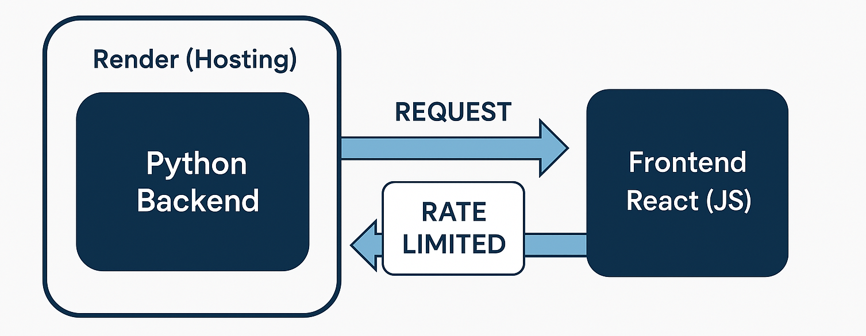
Back-End: The Harsh Reality
What We Did with the Backend:
Enabled multi-stock requests (Ex. /stock?symbol=AIRS,AAPL).
Integrated retrieval of the last 30 days of stock history.
Returned key data points: symbol, name, current price, current date, and history.
{
"current_price": 222.13,
"date": "2025-04-01 05:48:16",
"history": [... ]
"name": "Apple Inc.",
"symbol": "AAPL"
}

Slide 5
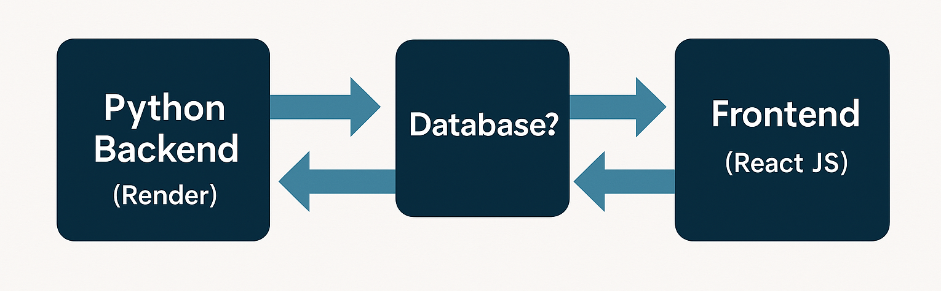
Future Backend Enhancements
Address yfinance rate limits: Hard-coding a complete stock list isn’t scalable. Implement lazy loading (Ex. 20 stocks per request) to manage performance.
Explore using a database or caching layer to store data: Reduce frequent calls to yfinance. Improve response times for high-volume requests.
Consider alternative APIs or combining data sources: yfinance alone doesn’t support fetching the entire stock universe. Organize our own database to maintain a comprehensive ticker list.

Slide 6
Future Backend Enhancements
API Security: Currently, the API endpoint is public; implement authentication to restrict access.
Develop additional endpoints: Different endpoints for minimal info (e.g., only name) versus detailed data.

Slide 7
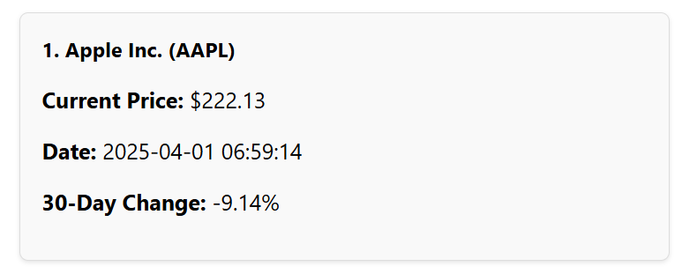
Home Page: Current Developments
The title of the App
Shows 5 cool stocks (generic stocks) with stats
This is formatted with some CSS to look good!
Display the description of the App

Slide 8
Home Page: Future Developments
Find a solution to allow the stocks to be pulled much more ofter and to actually determine the best stock there is out there in terms of % rising. (more of an api thing)

Slide 9
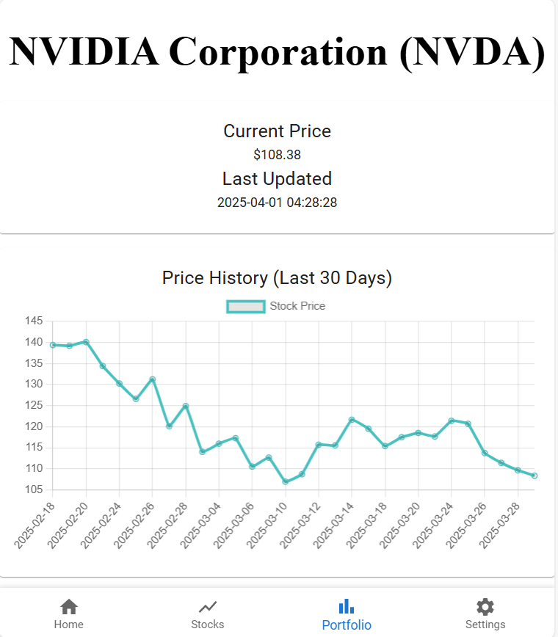
Stocks Info - Charts

Slide 10
Settings: Current Developments
Worked on:
Getting the Light/Dark theme
The FAQ/help

Slide 11
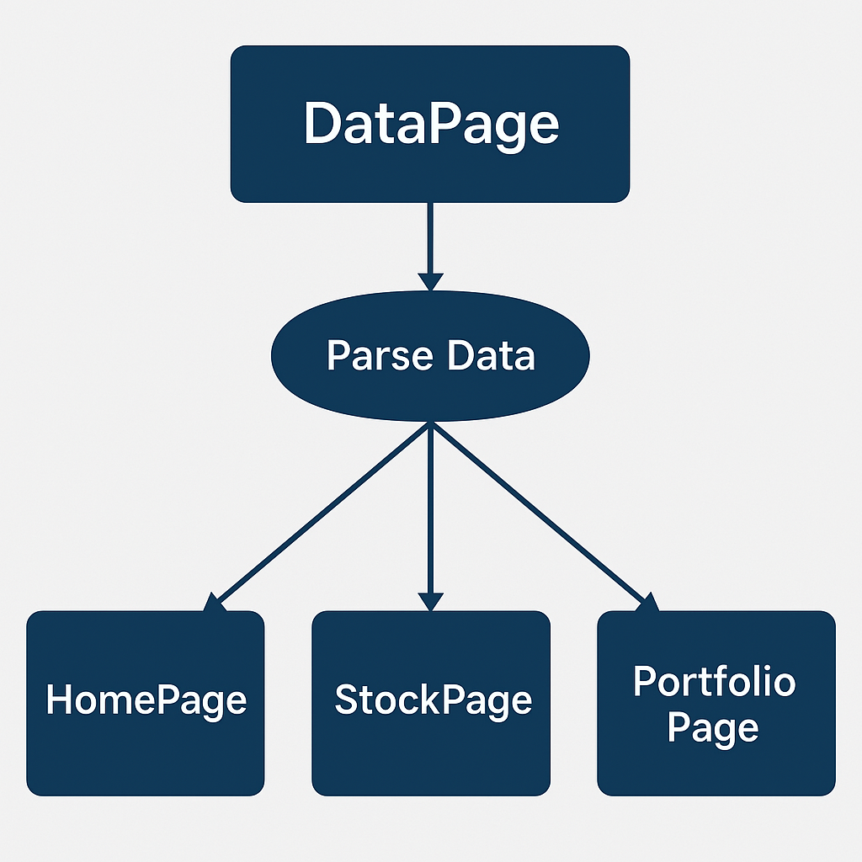
Overall future ideas
Currently, each component is responsible for fetching and processing its own data. To increase efficiency, we could implement a centralized data processing page that handles data parsing for all components, streamlining the process and reducing redundant requests.
Continue to work on each of the pages adding the features we want

